Slide 1

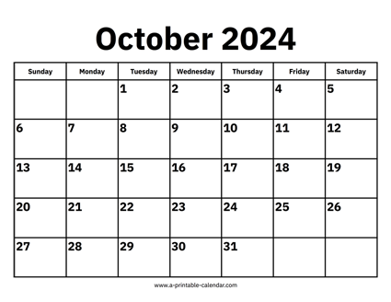

CS 310 : Scalable Software Architectures
Week 04 (Oct 14 – 18)
This week in CS 310:
Focus this week:
Building and designing web services
Class sessions on Tuesday, no class on Thursday
Tuesday class sessions are being recorded
Project 02 has been released, two steps:
Program web service for PhotoApp, rewrite client
Configure AWS EC2 to host web service
Both parts due Friday October 25th @ 11:59pm
Some optional readings on JavaScript coding:
https://bit.ly/async-js-intro-01
https://bit.ly/async-js-intro-02

Slide 2
Project 01 => Project 02

Slide 3
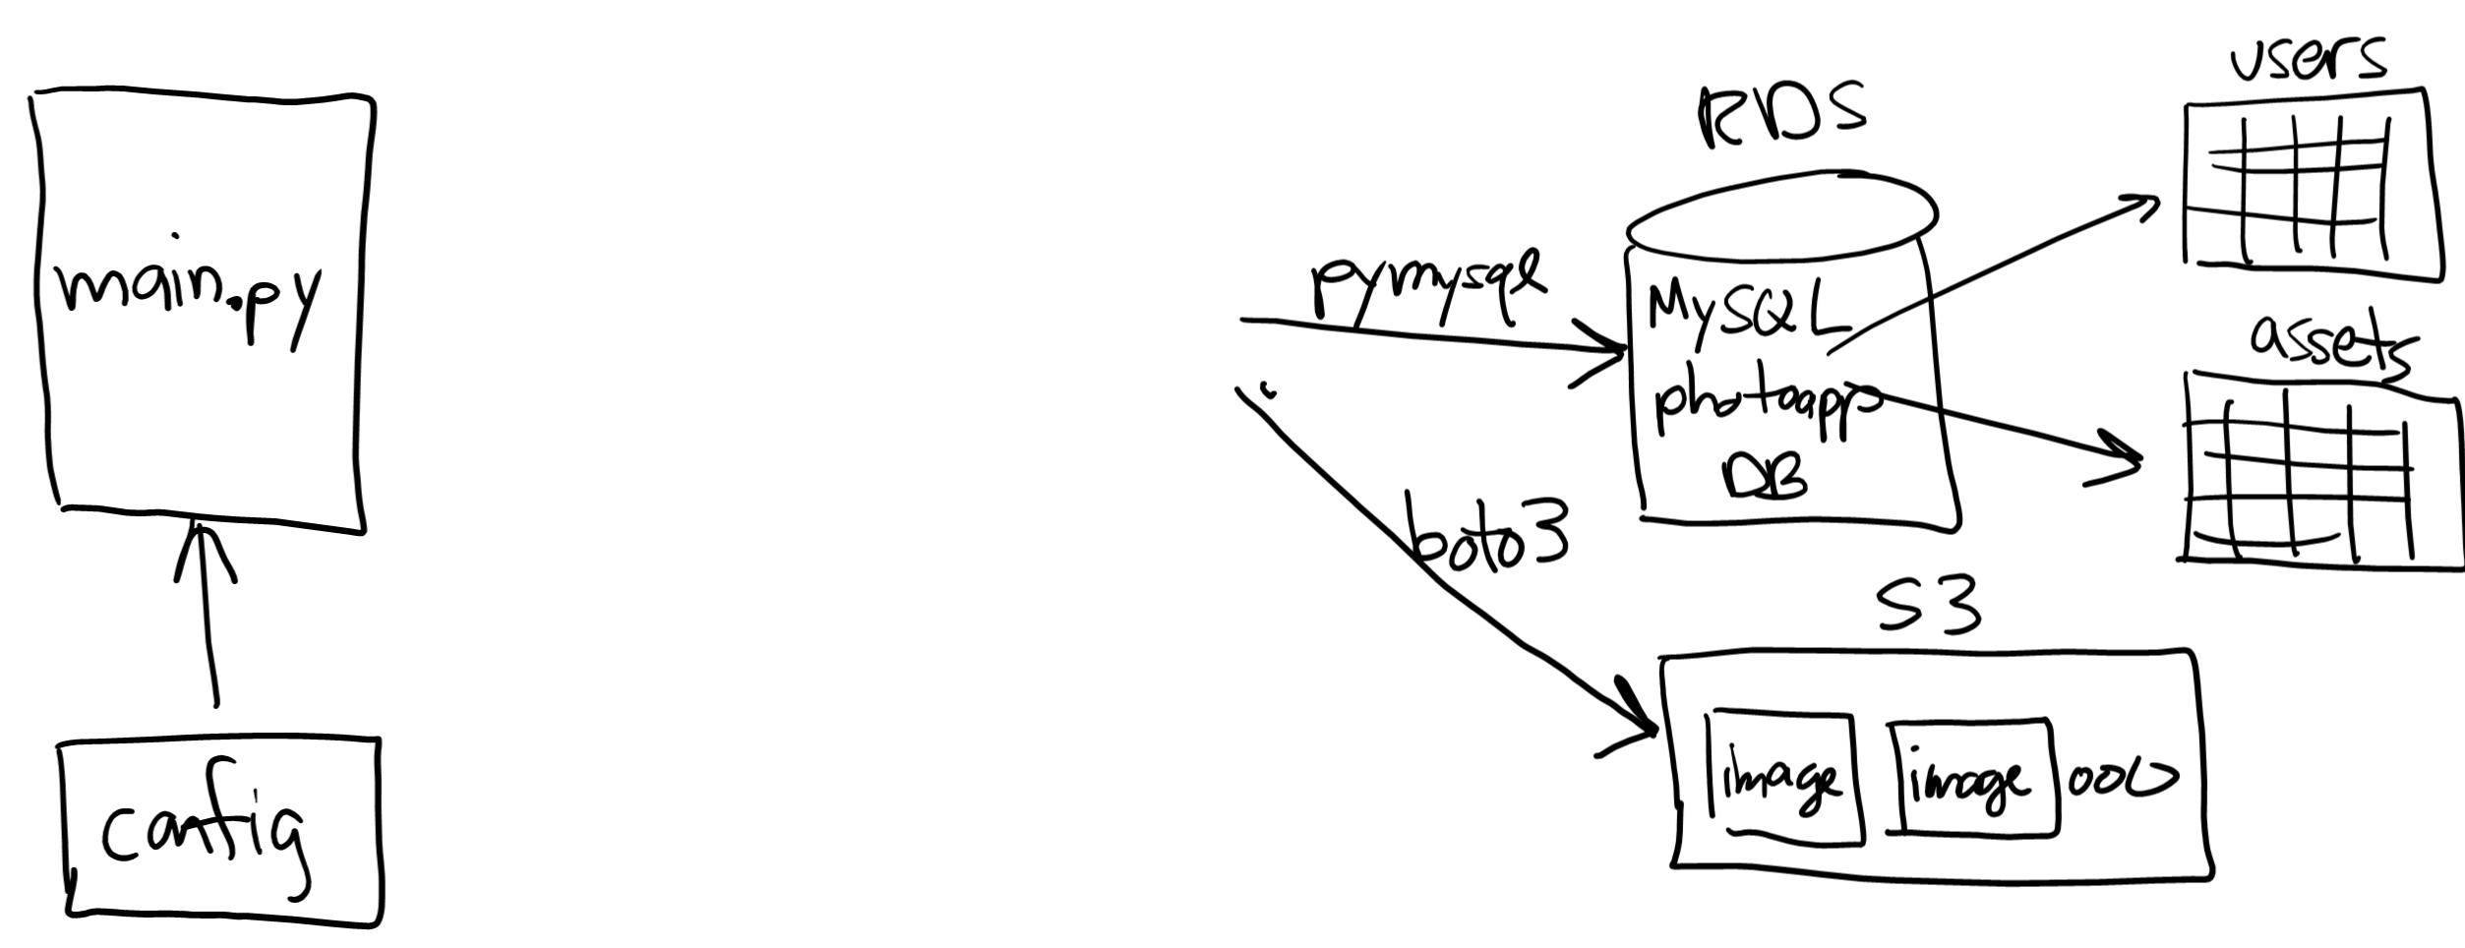






Project 01 => Project 02

Slide 4
Topics
Server-side JavaScript, Node.js and Express
Asynchronous execution
Designing a web service
RESTful APIs
Other approaches such as GraphQL

Slide 5
Class sessions
Summarize key points of lecture
Work with server-side JavaScript and Node.js
Asynchronous program design: callbacks vs. Promises
Note: no class sessions on Thursday, just Tuesday

